Slide 1
Android UID Essentials
Module - III

Slide 2
Android UI Layouts
The basic building block for user interface is a View object which is created from the View class and occupies a rectangular area on the screen and is responsible for drawing and event handling.
View is the base class for widgets, which are used to create interactive UI components like buttons, text fields, etc.
The ViewGroup is a subclass of View and provides invisible container that hold other Views or other ViewGroups and define their layout properties.

Slide 3
Layout Types
Linear Layout
LinearLayout is a view group that aligns all children in a single direction, vertically or horizontally.
Relative Layout
RelativeLayout is a view group that displays child views in relative positions.
Table Layout
TableLayout is a view that groups views into rows and columns.

Slide 4
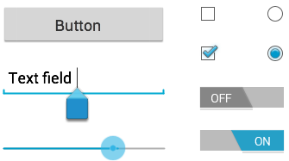
UI Input Controls
Input controls are the interactive components in your app's user interface. Android provides a wide variety of controls you can use in your UI, such as buttons, text fields, seek bars, check box, zoom buttons, toggle buttons, and many more.

Slide 5
UI Input Controls
A View is an object that draws something on the screen that the user can interact with and a ViewGroup is an object that holds other View (and ViewGroup) objects in order to define the layout of the user interface.

Slide 6
Few UI Input Controls
TextView
This control is used to display text to the user.
EditText
EditText is a predefined subclass of TextView that includes rich editing capabilities.
Button
A push-button that can be pressed, or clicked, by the user to perform an action.

Slide 7
Few UI Input Controls
TimePickerThe TimePicker view enables users to select a time of the day, in either 24-hour mode or AM/PM mode.
DatePickerThe DatePicker view enables users to select a date of the day.

Slide 8
TimePicker
Android Time Picker allows you to select the time of day in either 24 hour or AM/PM mode. The time consists of hours, minutes and clock format. Android provides this functionality through TimePicker class.
you have to first define the TimePicker component in your activity.xml. It is define as below or drag and drop
<TimePicker
android:id="@+id/timePicker1"
android:layout_width="wrap_content"
android:layout_height="wrap_content" />

Slide 9
TimePicker
import android.widget.TimePicker;
private TimePicker timePicker1;
timePicker1 = (TimePicker) findViewById(R.id.timePicker1);
In order to get the time selected by the user on the screen, you will use getCurrentHour() and getCurrentMinute() method of the TimePicker Class. Their syntax is given below.
int hour = timePicker1.getCurrentHour();
int min = timePicker1.getCurrentMinute();

Slide 10
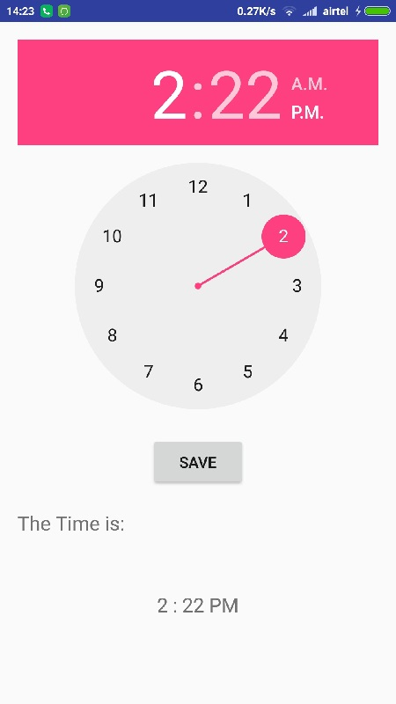
TimePicker Example

Slide 11
public class MainActivity extends Activity {
private TimePicker timePicker1;
private TextView time;
private Calendar calendar;
private String format = "";
@Override
protected void onCreate(Bundle savedInstanceState) {
super.onCreate(savedInstanceState);
setContentView(R.layout.activity_main);
timePicker1 = (TimePicker) findViewById(R.id.timePicker1);
time = (TextView) findViewById(R.id.textView1);
calendar = Calendar.getInstance();
int hour = calendar.get(Calendar.HOUR_OF_DAY);
int min = calendar.get(Calendar.MINUTE);
showTime(hour, min); }

Slide 12
public void showTime(int hour, int min) {
if (hour == 0) {
hour += 12;
format = "AM";
} else if (hour == 12) {
format = "PM";
} else if (hour > 12) {
hour -= 12;
format = "PM";
} else {
format = "AM"; }
time.setText(new StringBuilder().append(hour).append(" : ").append(min)
.append(" ").append(format)); }}

Slide 13
public void setTime(View view) {
int hour = timePicker1.getCurrentHour();
int min = timePicker1.getCurrentMinute();
showTime(hour, min);
}

Slide 14
Tips for CAT-1
Read all the questions very carefully
Write all the answers to the question asked
5 questions each carrying 10 marks
If program is required write the program
If snippets of code is required write the code and explanation
Draw diagrams wherever necessary
Try to answer the questions in order

Slide 15
Designing for Multiple Web browser

Slide 16
Designing for Multiple Web browser
Designing and developing for multiple mobile browsers simultaneously is a challenge, but not an impossibility.
It requires looking at your designs and code from many contexts, and being able to visualize how it will be rendered on a variety of devices in your head, as you lay down code.
For example, you are creating the markup and styles for a desktop site that has to support Internet Explorer 6, which has very quirky support for web standards techniques.

Slide 17
Progressive Enhancement
Progressive enhancement is the practice of using web techniques in a layered fashion to allow anyone with any web browser to access your content, regardless of its capabilities.
This means that you are creating not just one ideal experience, but multiple less-ideal experiences, depending on who views it, also called graceful degradation

Slide 18
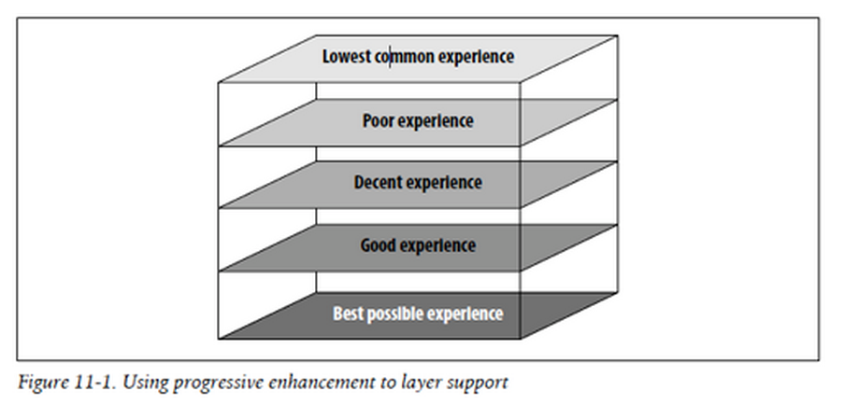
Progressive Enhancement

Slide 19
Progressive Enhancement
Our unstyled experience or markup viewed in its rendered form is at the center. We can assume that all devices can show at least this level of presentation.
Next, we add basic styling techniques for our lowest common denominator devices that support both our markup plus very basic styling techniques.
We continue to add layers until we reach the best possible experience on the outside.

Slide 20
Progressive Enhancement
It should be noted that you can add a desktop layer to your site using progressive enhancement.
There is absolutely nothing wrong with this approach, because you built the desktop layer on top of a layer designed for the mobile context.

Slide 21
Problems
The problems arise when you go the other way around, starting with the desktop and trying to create a useful mobile experience from it.
Nine times out of ten, you end up with an awkward, barely useful version of your site that is both slow and expensive to load.

Slide 22
Mobile Progressive Enhancement Techniques
Regardless of how advanced browsers have become, I still employ these five techniques for every mobile project
Always code your markup semantically. keep a live preview window open so that I can see the rendered page as you code.
Have a device plan. Know which device classes you intend to support before you start to code. This will influence how you code your pages.

Slide 23
Mobile Progressive Enhancement Techniques
Have both your lowest common denominator devices and your high-end device designs before you begin to code. Try to visualize a way to create both versions from one code base.
Test on different mobile devices from the beginning to the end to ensure that your incremental work will display correctly in the intended devices.
If you plan to add a desktop layer, always create the mobile version first.

Slide 24
Designing for Multiple Displays

Slide 25
Designing for Multiple Displays
It is both a design and development dilemma, but if you ask any mobile designer, it is quite a painful headache.
When trying to design and develop a mobile experience, you have to remember that your design might be viewed on a small 120-pixel screen, common on most lower-end phones, or on a 320-pixel screen common to most smart phones.
Depending on the type of devices you plan to support, it is entirely possible that it could be viewed on larger screens; many smartphones now can be rotated to landscape mode, increasing the view to 480 pixels.

Slide 26
Fixed versus fluid designs
Traditionally, in the mobile industry developers have opted for fixed-width designs over fluid, or percentage-based, stretchable designs.
Fixed-width has provided slightly more reliable rendering across devices in the past; however, the problem with fixed-width design is that it might limit the viewable content when viewed on larger screens.
We are seeing a trend toward larger screens as well as the inclusion of orientation switching in device browsers.
Therefore, I recommend that you make all designs fluid by default, unless you are targeting a device that you specifically know has issues rendering a fluid design.

Slide 27
Single-column versus multiple-column layouts
As mobile screens get larger, does that mean we can start to use multicolumn layouts? For example, should you use sidebars or vertical navigation areas?
There are historical, technical reasons why you might not want to employ a multicolumn layout on a lower-end device:
poor support for positioning or floats, not to mention that these devices typically have smaller screens, where two columns would make the page cluttered are just a couple of examples.

Slide 28
Designing for Multiple Devices

Slide 29
Adapting to Devices
devices can be vastly different from each other
It would be easy if different devices simply supported different attributes—one supports CSS3 and one doesn’t.
But it isn’t that easy.
One device might support CSS3 and another device might support CSS3 poorly—or worse, incorrectly.

Slide 30
Strategy #1: Do Nothing
Our first of four multiserving strategies is to simply do nothing, or rather to wait for the technology to adapt to our principles—which actually isn’t as foolish as it might sound
Initially, the W3C defined One Web this way:
One Web means making the same information and services available to users irrespective of the device they are using.
In other words, content should be published once and the device should be smart enough to know what to render; effectively, we wouldn’t need to do anything more than ensure that our content meets the content standards

Slide 31
Strategy #2: Progressive Enhancement
technique of using web techniques in a layered fashion to allow anyone with any web browser to access your content, regardless of the browser’s capabilities. This is actually our second multiserving strategy.
Though progressive enhancement is normally thought of as a development strategy, it can also be used as an adaptation strategy as well, going through each of the three steps of multiserving

Slide 32
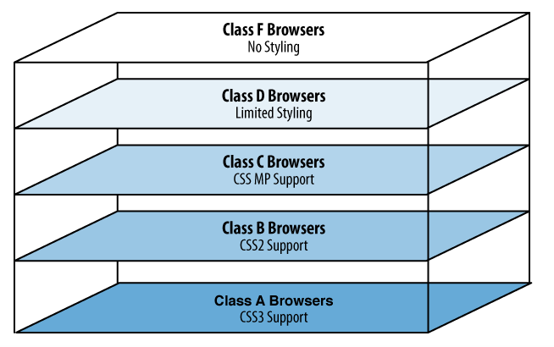
Strategy #2: Progressive Enhancement

Slide 33
Strategy #3: Device Targeting
calling out specific devices by class or model and delivering an experience designed with that device in mind.
In this strategy, we don’t assume that browsers are trustworthy enough to get to where they need to be. Therefore, in this strategy, the first step of multiserving is to reliably detect the device.
Settings – > About Phone

Slide 34
Strategy #4: Full Adaptation
the process of making extremely unique mobile experiences based on the device that is requesting the content—almost always dynamically.
Like the other multiserving strategies, it starts with detecting the device that is requesting content and matching that to a valid user-agent string; then the system outputs markup, styles, and images generated exclusively for that device.

Slide 35
Strategy #4: Full Adaptation
Let’s say, for example, that we want to support 20 devices across multiple operators. These devices carry browsers that range from Class A to Class D, each with different screen sizes and device capabilities. Using a full adaptation strategy, we detect, adapt, and render, but then we take it a step further. For each request, we detect each of those device’s user-agent strings against our device database and then dynamically adapt our base templates to suit that device class and render to the device.

Slide 36
What Domain Do I Use?
Ideally, the user should have to enter only your primary URL—for example, domain.com—and your multiserving system should route him to the appropriate experience for his device and context.
The most common method is to prefix your site domain with a subdomain called “m”—for example, m.your-domain-name.com

Slide 37
Digital Assignment 1
Topic: Fragments Lifecycle
Last Date: 24/01/2019
Submission in Edmodo
Marks: 10

Slide 38
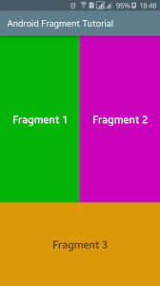
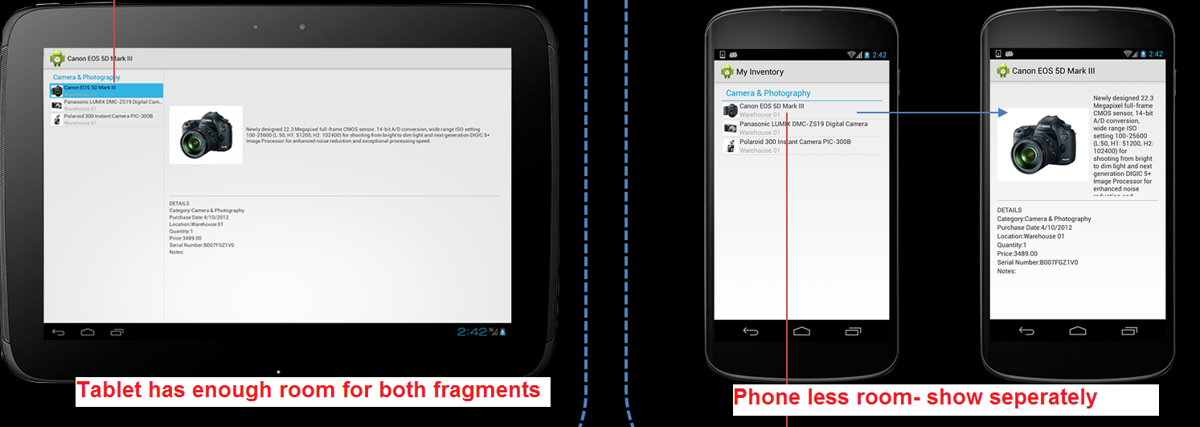
Fragment
An activity is a container for views
When you have a larger screen device than a phone –like a tablet it can look too simple to use phone interface here.
→ Fragments
Mini-activities, each with its own set of views
One or more fragments can be embedded in an Activity
You can do this dynamically as a function of the device type (tablet or not) or orientation
ALSO, you can reuse fragments --- like reuse of mini interfaces

Slide 39
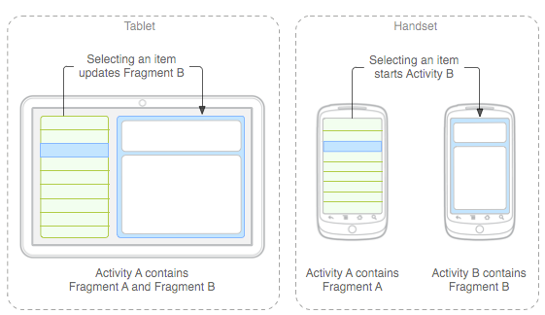
Fragment Idea
primarily to support more dynamic and flexible UI designs on large screens, such as tablets.
→ Fragments
Mini-activities, each with its own set of views
One or more fragments can be embedded in an Activity
You can do this dynamically as a function of the device type (tablet or not) or orientation
You might decide to run a tablet in portrait mode with the handset model of only one fragment in an Activity

Slide 40
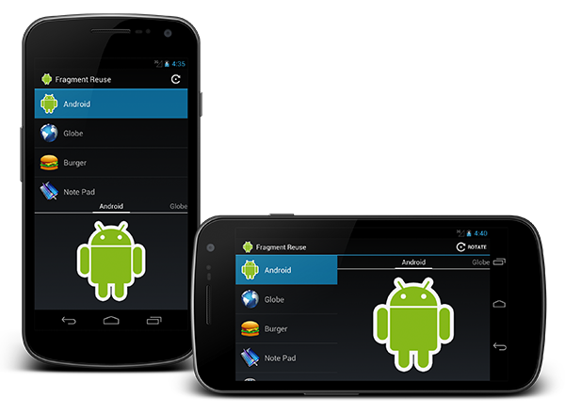
Fragment
Activity= 2 Fragments
A Fragment represents a behavior or a portion of user interface in an Activity.
You can combine multiple fragments in a single activity to build a multi-pane UI and reuse a fragment in multiple activities.
You can think of a fragment as a modular section of an activity, which has its own lifecycle, receives its own input events, and which you can add or remove while the activity is running (sort of like a "sub activity" that you can reuse in different activities).

Slide 41
Animated Illustration of Fragment as part of UI—changing (replacing)
Starting:
FragementTransaction: replace Fragment 1 with Fragment 2
Activity
TextView
Fragment 1
Activity
TextView
Fragment 2

Slide 42
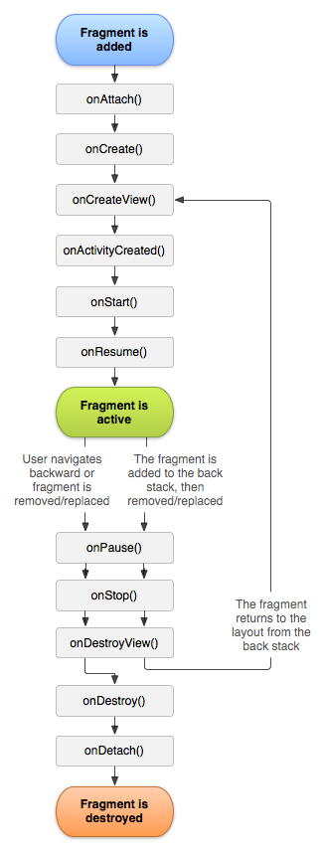
Fragment Lifecycle
Fragment in an Activity---Activity Lifecyle influences
Activity paused → all its fragments paused
Activity destroyed → all its fragments are destroyed
Activity running → manipulate each fragment independently.
Fragment transaction →add, remove, etc.
adds it to a back stack that's managed by the activity—each back stack entry in the activity is a record of the fragment transaction that occurred.
The back stack allows the user to reverse a fragment transaction (navigate backwards), by pressing the Back button.

Slide 44
Fragment methods (callback functions)
onAttach(Activity) called once the fragment is associated with its activity.
onCreate(Bundle) called to do initial creation of the fragment.
onCreateView(LayoutInflater, ViewGroup, Bundle) creates and returns the view hierarchy associated with the fragment.
onActivityCreated(Bundle) tells the fragment that its activity has completed its own Activity.onCreate.
onStart() makes the fragment visible to the user (based on its containing activity being started).
onResume() makes the fragment interacting with the user (based on its containing activity being resumed).

Slide 45
Fragment methods (callback functions)
As a fragment is no longer being used, it goes through a reverse series of callbacks:
onPause() fragment is no longer interacting with the user either because its activity is being paused or a fragment operation is modifying it in the activity.
onStop() fragment is no longer visible to the user either because its activity is being stopped or a fragment operation is modifying it in the activity.
onDestroyView() allows the fragment to clean up resources associated with its View.
onDestroy() called to do final cleanup of the fragment's state.
onDetach() called immediately prior to the fragment no longer being associated with its activity.

Slide 46
Project Review - II
Will happen after CAT – II
Team Members
Implementation required
No PPT

Slide 47
Feedback
How to do you think this course is run?
Write down few points about how the course can be improved
Write down few points for the faculty to improve in teaching, behavior or any other means for better learning of this course

